Slide 1
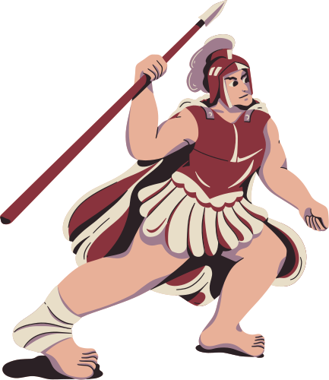
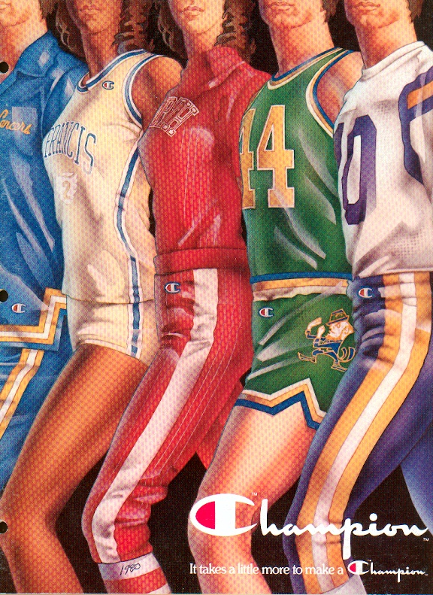
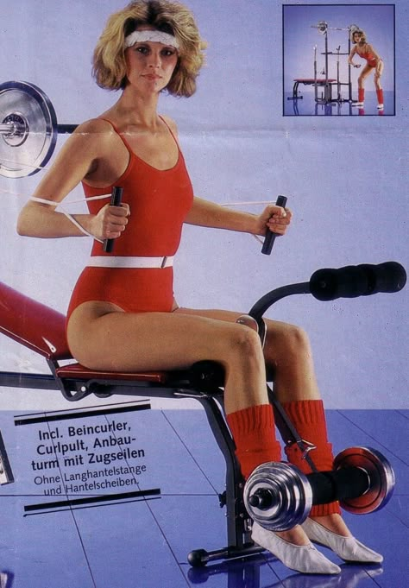

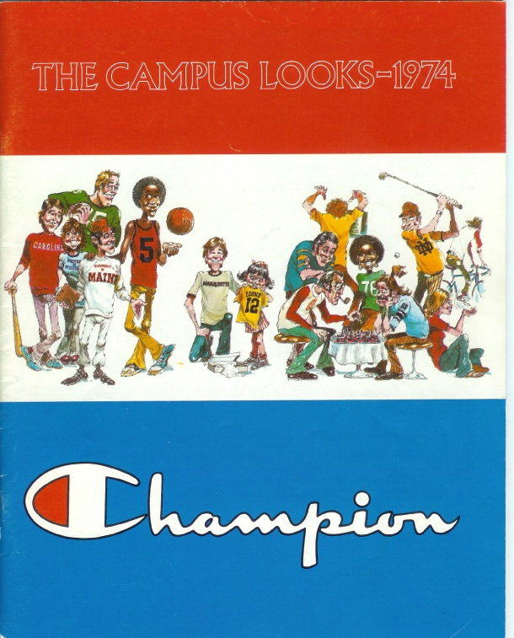
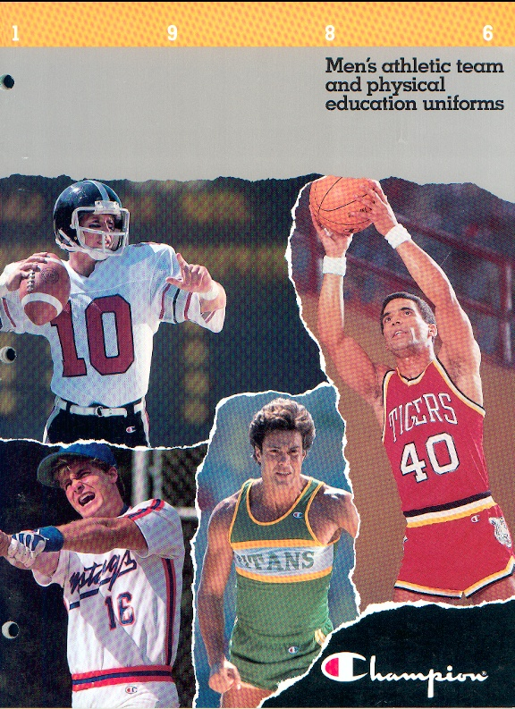
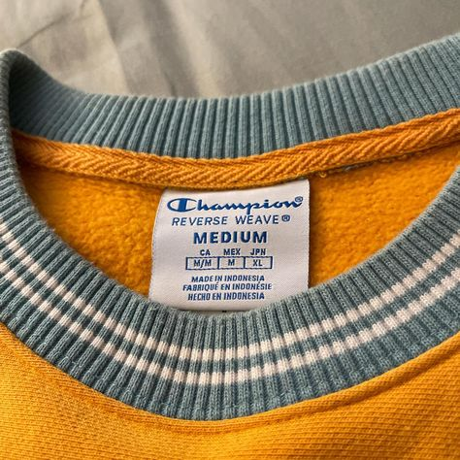
March 11, 2025
Behavioral Customer Segmentation
By- vanshika gupta
Marketing Analytics

Slide 2
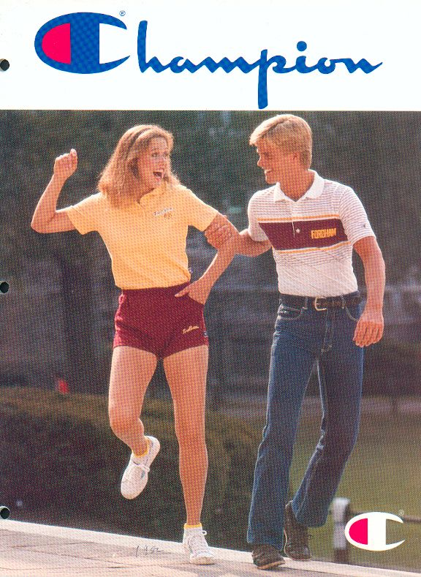




BUSINESS SITUATION
Champion, formerly under Hanesbrands Inc., was acquired by Authentic Brands Group in September 2024
The brand primarily focuses on influencer marketing, digital/social media advertising, and retail partnerships
Key strategic priority is to expand the Direct-to-Consumer business via Champion.com to improve revenue, customer loyalty, and data-driven marketing strategies
The project analyzes 20,907 Champion.com customers to develop an RFM-based CRM strategy that will drive customer retention, engagement, and spending

Slide 3
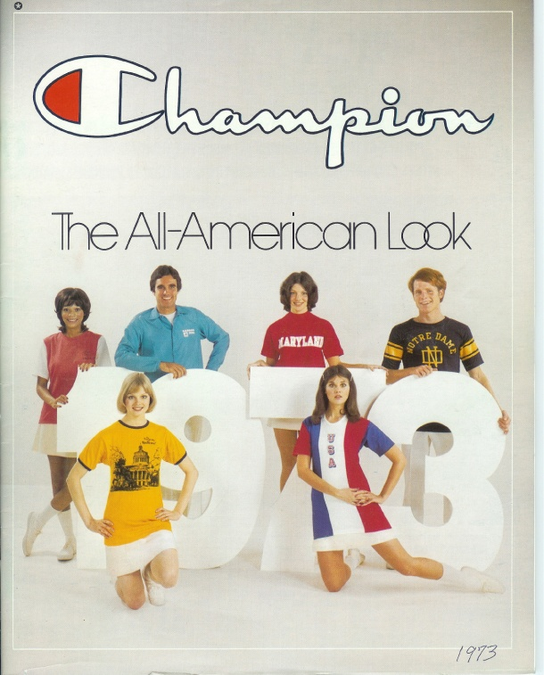
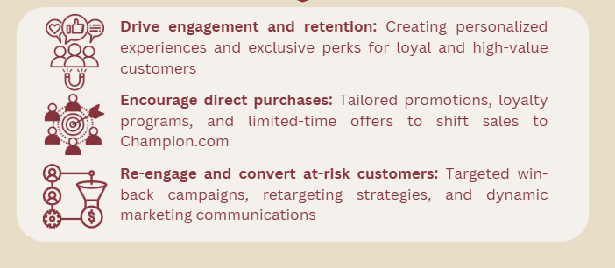
CRM & Marketing communication objectives
“Enhancing Customer Engagement & Strengthening DTC Sales through Personalized and Targeted Marketing Strategies”

Slide 4
Segmentation Approach
01
Behavior-Based Segmentation
02
Defining Customer Groups
03
Utilizing Data for Targeted Actions
Customers’ level of engagement with Champion.com using
RFM analysis
Loyal Customers
→ High purchase frequency and strong retention
Assign personalized engagement strategies based on each segment’s behavior
Inactive Customers
→ Moderate purchase history, potential for increased engagement
Incorporates additional behavioral factors
(e.g., promotion usage and retention scores) to refine the customer groups
At Risk Customers
→ Declining activity, requiring targeted re-engagement

Slide 5
primary SAS Studio tasks
1
3
5
Summary Statistics (Final)
Generates summary statistics to validate and analyze final segments
Rank Data Task
Converts continuous data into categories for segmentation
Summary Statistics
Provides a descriptive profile of each subgroup with key insights
2
4
Combine Categories (SAS Code)
merge categorical values into a single classification
Group into Segments
(SAS Code)
Groups subgroups into meaningful customer segments

Slide 6
The customer Segmentation solution
1.The Inner Circle | These customers buy frequently and/or spend a lot, making them top buyers
2. Almost Exclusive | They engage but do not spend high amounts, opportunity to convert to high-value customers
3. Fading Buyers | Haven’t purchased in a while or are declining in engagement
4. Unpredictable Guests | They spend a lot but don’t buy frequently
5. Luxury Drifters | Rarely buy, but when they do, they spend a lot
(011)
(000, 010)
(100, 110)
(001, 101)
(111)

Slide 7
customer profile segment (1/2)
Profile Element | The Inner Circle | Almost Exclusive | Fading Buyers | Unpredictable Guests | Luxury Drifters
Recency | 70 | 79 | 262 | 179 | 267
Frequency | 4.4 | 1.3 | 1.2 | 1.7 | 4
Monetary | $259 | $39 | $35 | $134 | $252
Avg. Items per order | 2 | 1.3 | 1.3 | 2.6 | 2.1
Avg. Revenue per order | $60 | $33 | $30 | $81 | $63
% Customers that Used a Promotional Offer | 93% | 22% | 27% | 49% | 89%
Estimated Annual Retention Rate | 82% | 58% | 36% | 57% | 65%

Slide 8
customer profile segment (2/2)
Profile Element | The Inner Circle | Almost Exclusive | Fading Buyers | Unpredictable Guests | Luxury Drifters
% Customers that only purchased women’s products | 45% | 47% | 35% | 45% | 39%
% Customers that only purchased men’s products | 33% | 49% | 62% | 47% | 40%
% Customers that purchased women’s and men’s products | 20% | 0 | 2% | 6% | 16%
% Customers whose purchases included kids products | 24% | 3% | 1% | 2% | 5%

Slide 9
Customer Lifetime Value Analysis
Segment | Annual Contribution Margin | Retention Rate | Years of Purchasing Life | CLV
1.The Inner Circle | 258.4 | 82.0% | 5.6 years | $ 1,073.4
2. Almost Exclusive | 39.1 | 56.8% | 2.3 years | $ 82.5
3. Fading Buyers | 34.5 | 35.8% | 1.6 years | $ 51.6
4. Unpredictable Guests | 134.1 | 56.8% | 2.3 years | $ 282.9
5. Luxury Drifters | 251.5 | 64.6% | 2.8 years | $ 625.8

Slide 10
recommendations by segment
1.
The Inner Circle
With a 0.82 retention score, these high-value customers need exclusive experiences. Champion should introduce VIP perks like early access to limited edition drop for top spenders, styling recommendations and lifetime free shipping. Since 92.9% use promotions, replace discounts with bonus points multipliers and milestone rewards to strengthen long-term loyalty.
2.
Almost Exclusive
This segment is engaged but has low spending (57% retention). To boost consistency, Champion should introduce a “Champion+” subscription ($9.99/month) offering exclusive discounts, free shipping, and early sale access (only while subscribed). A 90-day free trial can encourage adoption, turning them into recurring shoppers.
3.
Fading Buyers
With low retention and CLV, these customers need strong re-engagement tactics. Champion should send personalized win-back emails with exclusive discounts and restock alerts to spark interest. Reactivation bundles (e.g., jogger + hoodie sets) with mystery gifts can increase excitement, while double loyalty points on their first two purchases encourage repeat buying.
4.
Unpredictable Guests
These high spenders shop infrequently but value exclusivity. Champion should offer invite-only VIP sales, AI-driven product recommendations, and high-end “Complete Your Look” bundles. A “Customize Your Champion” option (monograms, exclusive embroidery) adds a premium touch, keeping them engaged.
5.
Luxury Drifters
With sporadic shopping habits, traditional loyalty programs won’t work. Instead, Champion should use mystery checkout rewards, flash sales, and exclusive contests (e.g., “Shop now for a chance to win $500”) to create excitement and drive impulse purchases.

Slide 11
Marketing Budget
Allocation Recommendations
Segment Name | % of Customer | CLV | Marketing Allocation Recommendation | Marketing Budget Allocation Rationale
The Inner Circle | 13% | $ 1,073.4 (Highest CLV) | 30% – VIP loyalty programs, exclusive discounts, early access sales | Retaining top spenders increases overall revenue; they have the highest retention & engagement.
Almost Exclusive | 24% | $ 82.5 (Medium CLV) | 18% – Personalized promotions, bundle discounts, loyalty rewards | Incentivizing higher spending increases their value, converting them into long-term high-value customers.
Fading Buyers | 26% | $ 51.6 (Low CLV) | 17% – Win-back campaigns, re-engagement discounts, targeted email marketing | Reducing churn prevents customer loss; targeted offers can reactivate lapsed buyers.
Unpredictable Guests | 27% | $ 282.9 (High CLV) | 20% – Personalized product recommendations, seasonal sale nudges, limited-time offers | Encouraging frequent purchases increases revenue from occasional high spenders.
Luxury Drifters | 9% | $ 625.8 (High CLV) | 15% – Exclusive limited-edition drops, premium memberships, high-end collaborations | These customers buy infrequently but spend a lot. Keeping them engaged through premium offerings ensures continued high-value purchases.

Slide 12
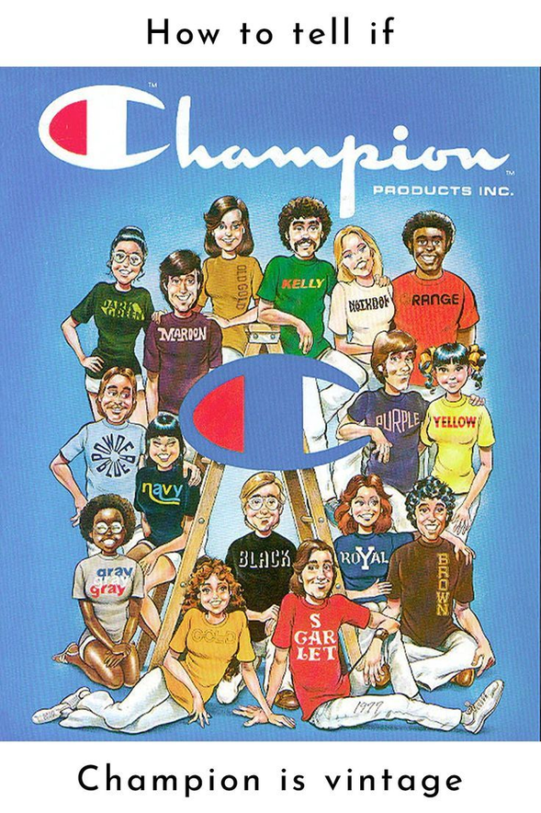
Conclusion
“The goal was to enhance customer engagement and drive direct-to-consumer (DTC) growth
through data-driven segmentation.”
To maximize revenue and CLV, high-value customers (i.e., The Inner Circle and Luxury Drifters) should be retained through VIP programs, premium offerings, and personalized experiences.
Strategic marketing allocation to prioritize top spenders while using
targeted promotions to reengage buyers and ensure long-term loyalty
and optimized profitability.

Slide 13
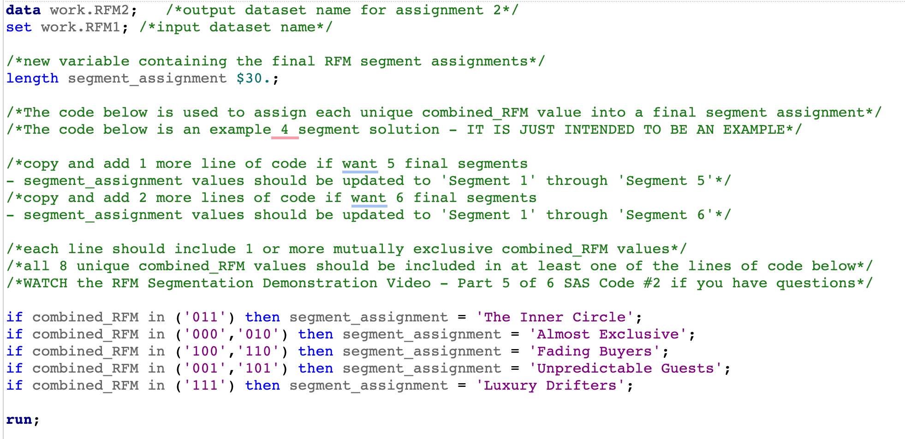
Appendix

Slide 14
